Slide 1


Slide 2
WHO ARE WE?
A global leader in digital automotive solutions, driven by passion for automotive. Also known as A PARTNER WITH A DIFFERENCE in the automotive world!

Slide 3
HOW DO WE CREATE A DIFFERENCE ?
23 Years of serving the Automotive Ecosystem.
Working with some of the biggest Automotive companies.
Ensuring sustainable growth and smarter Ecosystems.
Delivering unparalleled end customer experience.
Automotive Industry Experts offering business consulting through Thought Leadership.

Slide 4


Slide 5
WHY US?
Winning Team: Automotive experts, consultants, engineers & market intelligence specialists
DNA :Providing disruptive technological solutions
Leading with the Latest: Adapting to the latest tech faster than anyone
Multidisciplinary IT services: Entire customer journey covered
Experience That Counts: More than 4000+ man-years of total experience.
Holistic Approach: 360 Degree view of the entire automotive ecosystem.
Everything covered : Unmatched combination of solutions, expertise and knowledge.

Slide 6
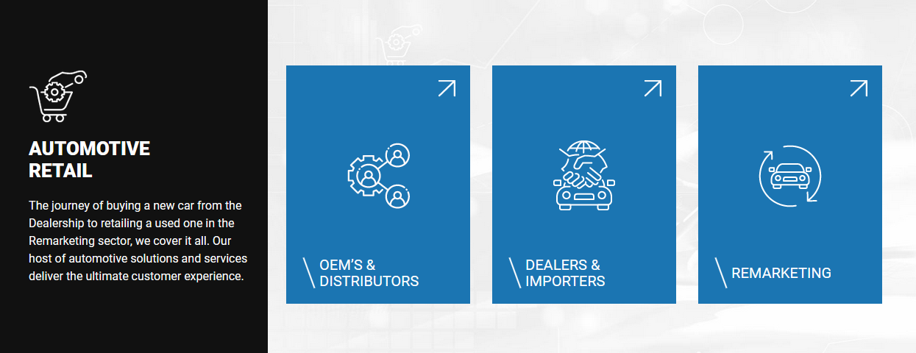
Segments We Serve

Slide 7
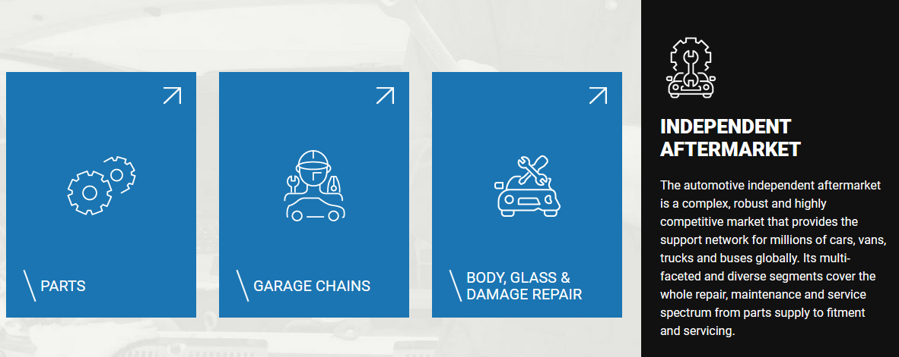
Segments We Serve

Slide 8
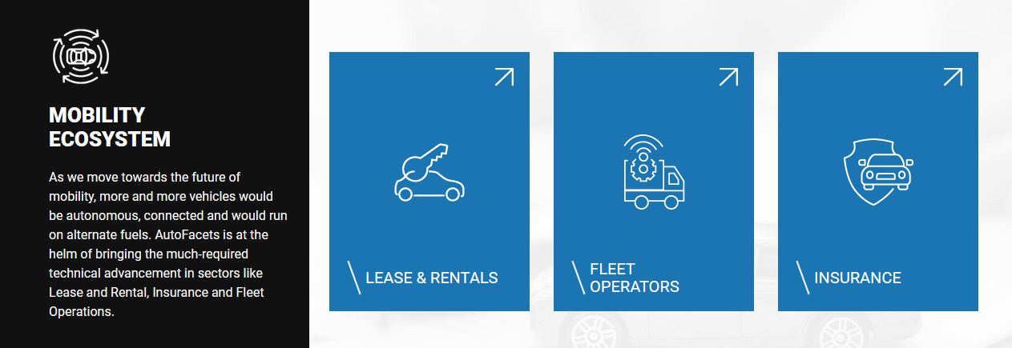
Segments We Serve

Slide 9
AUOTMOTIVE RETAIL
OEM’S AND DISTRIBUTORS
DEALERS AND IMPORTERS
REMARKETING

Slide 10
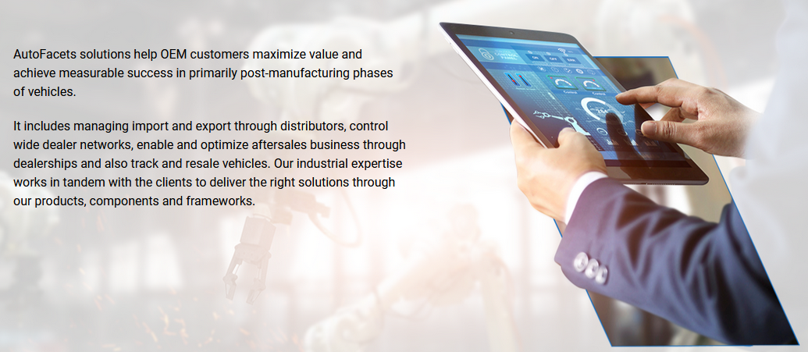
OEM’S AND DISTRIBUTORS

Slide 11
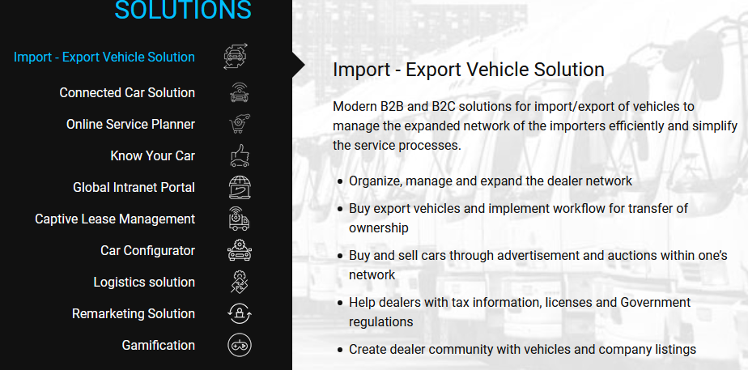
OEM’S AND DISTRIBUTORS

Slide 12
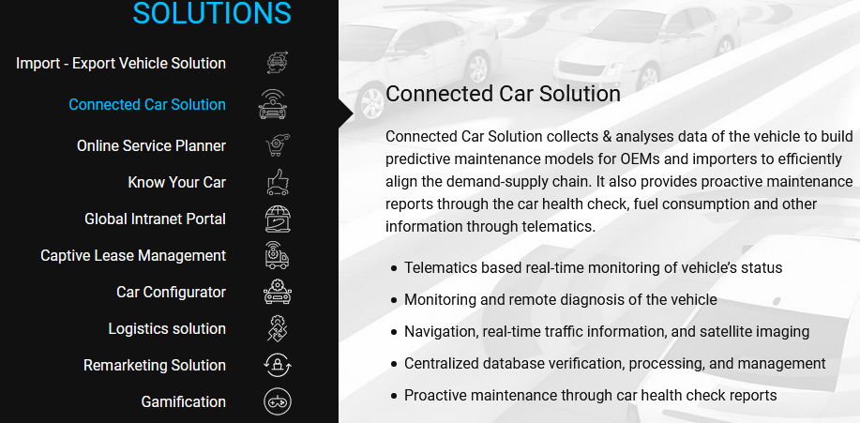
OEM’S AND DISTRIBUTORS

Slide 13
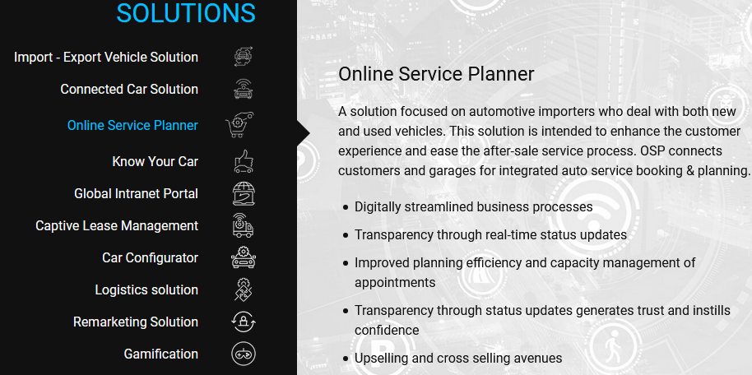
OEM’S AND DISTRIBUTORS

Slide 14
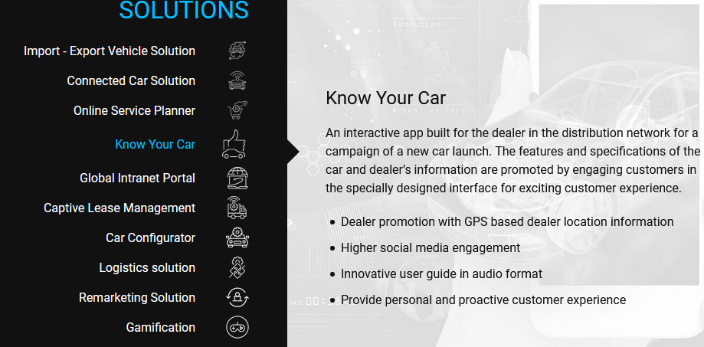
OEM’S AND DISTRIBUTORS

Slide 15
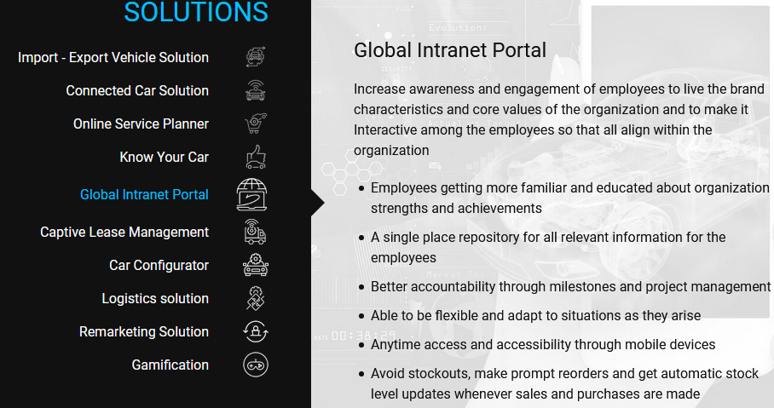
OEM’S AND DISTRIBUTORS

Slide 16
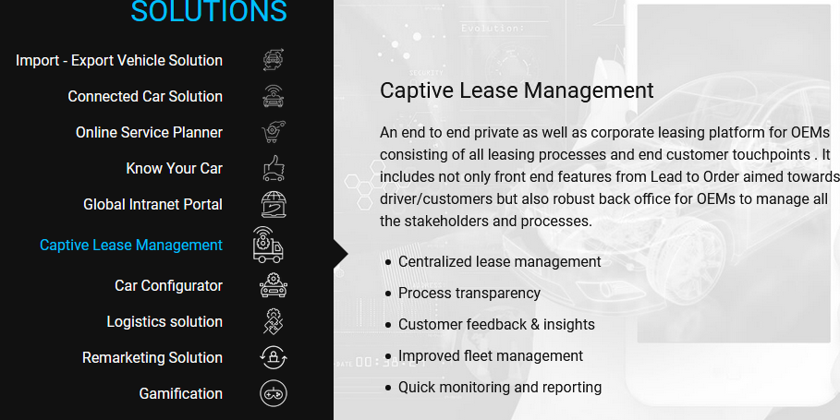
OEM’S AND DISTRIBUTORS

Slide 17
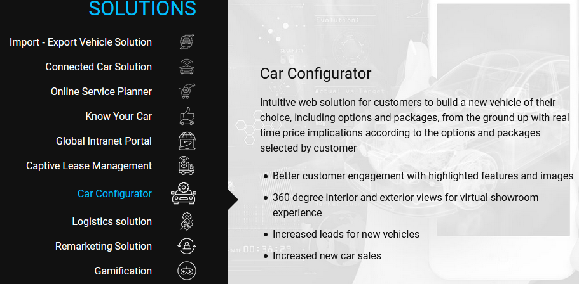
OEM’S AND DISTRIBUTORS

Slide 18
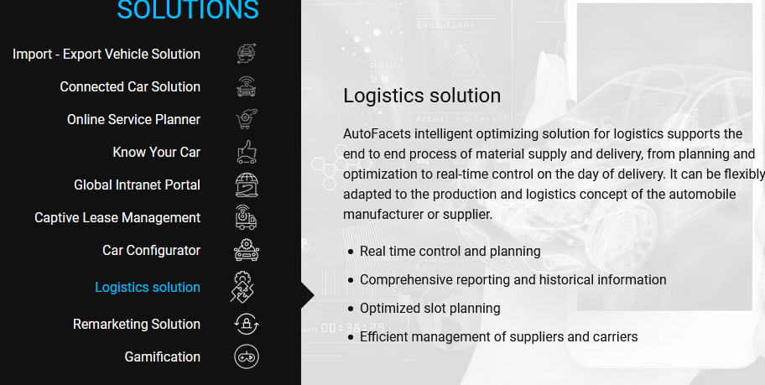
OEM’S AND DISTRIBUTORS

Slide 19
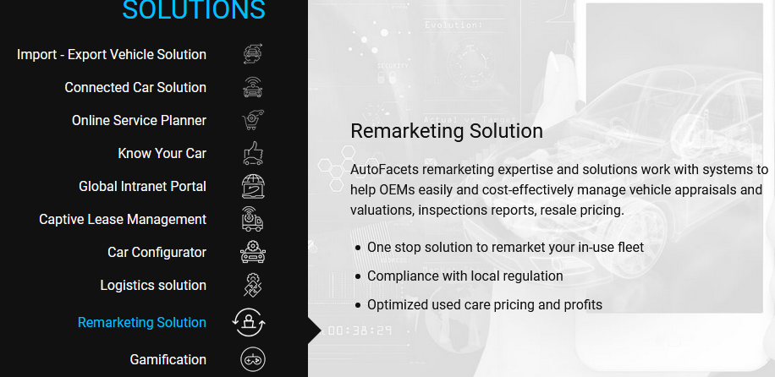
OEM’S AND DISTRIBUTORS

Slide 20
THANK YOU

